Slide 1
Pointers

Slide 2
Introduction to Pointers
When we declare a variable, some memory is allocated for it.
Thus, we have two properties for any variable:
Its Address
and its Data value
E.g., char ch = ‘A’;
Memory Address
Value
ch
311
65

Slide 3
Introduction to Pointers
How to get the memory-address of a variable?
Address of a variable can be accessed through the referencing operator “&”
Example: &i 🡺 will return memory location where the data value for “i” is stored.
A pointer is a variable, that stores an address.

Slide 4
Introduction to Pointers
We can declare pointers as follows:
Type* <variable Name>;
Example:
int* P;
- creates a pointer variable named “P”, that will store address (memory location) of some int type variable.

Slide 5
The address of Operator &
The & operator can be used to determine the address of a variable, which can be assigned to a pointer variable
Examples:
Notes:
int* p1;
int v1=99;
p1 = &v1;
Now p1 points to the memory location,
where v1 is stored.
- v1 is an integer variable
- P1 is a integer pointer

Slide 6
Dereferencing Operator *
C++ uses the * operator in yet another way with pointers
"The variable values pointed to by p" 🡪 *p
Here the * is the dereferencing operator
p is said to be dereferenced
int v1=99;
int* p= &v1;
cout<<“ P points to the value: “<<*p;

Slide 7
Dereferencing Pointer Example
int v1 = 0; int* p1 = &v1; *p1 = 42; cout << v1 << endl; cout << *p1 << endl;
v1 and *p1 now refer to the same variable
Output:
42
42

Slide 8
Pointer Assignment and Dereferencing
Assignment operator ( = ) is used to assign value of one pointer to another
Pointer stores addresses so p1=p2 copies an address value into another pointer
int v1 = 55; int* p1 = &v1; int* p2;
p2=p1; cout << *p1 << endl; cout << *p2 << endl;
Output:
55
55

Slide 9
Example
char *string = “hello”;
const int iSize=8;
char* f(int x)
{
char *p;
p = new char[iSize];
return p;
}
0
text
data
bss
heap
0xffffffff
stack

Slide 10
Example
int main()
{
int *p;
p = new int;
return 0;
}
0
text
data
bss
heap
p
0xffffffff
stack

Slide 11
Example
int main()
{
int *p;
p = new int;
return 0;
}
0
text
data
bss
heap
#@%*&
p
0xffffffff
stack

Slide 12
Example
int main()
{
int *p;
p = new int;
*p = 99;
return 0;
}
0
text
data
bss
heap
99
p
0xffffffff
stack

Slide 13
Aliasing
int main()
{
int *p, *q;
p = new int;
*p = 99;
q = p;
return 0;
}
0
text
data
bss
heap
99
q
p
0xffffffff
stack

Slide 14
Aliasing
int main()
{
int *p, *q;
p = new int;
*p = 99;
q = p;
*q = 88;
return 0;
}
0
text
data
bss
heap
88
q
p
0xffffffff
stack

Slide 15
Aliasing
int main()
{
int *p, *q;
p = new int;
*p = 99;
q = p;
*q = 88;
delete q;
return 0;
}
0
text
data
bss
heap
$%#^&
q
p
0xffffffff
stack
Notes:
P and q still points to the same memory location (that may have same or different value)

Slide 16
Dangling Pointers
int main()
{
int *p, *q;
p = new int;
*p = 99;
q = p;
*q = 88;
delete q;
*p = 77;
return 0;
}
0
text
P and q are dangling pointers
WHY?
data
bss
heap
$%#^&
q
p
0xffffffff
stack
Notes:
P and q🡪 don't point to a valid allocated memory.

Slide 17
Dangling Pointers
The delete operator does not delete the pointer, it takes the memory being pointed to and returns it to the heap
It does not even change the contents of the pointer
Since the memory being pointed to is no longer available (and may even be given to another application), such a pointer is said to be dangling

Slide 18
Avoiding a Dangling Pointer
For Variables:
delete v1;
v1 = NULL;
For Arrays:
delete[ ] arr;
arr = NULL;

Slide 19
Returning Memory to the Heap
Remember:
Return memory to the heap before undangling the pointer
What's Wrong with the Following:
ptr = NULL;
delete ptr;

Slide 20
Memory Leaking
int main()
{
int *p;
p = new int;
// make the above space unreachable; How?
p = new int;
// even worse…; WHY?
while (1)
p = new int;
return 0;
}

Slide 21
Memory Leaking
void f ( )
{
int *p;
p = new int;
return;
}
int main ( )
{
f ( );
return 0;
}

Slide 22
Memory Leaks
Memory leaks when it is allocated from the heap using the new operator but not returned to the heap using the delete operator

Slide 23
Another Pointer Example
int i = 1;
int j = 2;
int* ptr;
ptr = &i; // ptr points to location of i
*ptr = 3; // contents of i are updated
ptr = &j; // ptr points to location of j
*ptr = 4; // contents of j are updated
cout << i << " " << j << endl;
Output:
3
4

Slide 24
Relationship Between Pointers and Arrays
Arrays and pointers are closely related
Array name is like constant pointer
All arrays elements are placed in the consecutive locations.
Example:- int List [10]; List is the start address of array
Pointers can do array subscripting operations We can access array elements using pointers.
Example:- int value = List [2]; //value assignment
int* p = List; //address assignment

Slide 25
Relationship Between Pointers and Arrays (Cont.)
Effect:-
- List is an address, no need for &
- The bPtr pointer will contain the address of the first element of array List.
Element List[2] can be accessed by *( bPtr + 2 )

Slide 26
Relationship between Arrays and Pointers
Arrays and pointers are closely related:
void main()
{
int numbers[]={10,20,30,40,50};
cout<<numbers[0]<<endl;
cout<<numbers<<endl;
cout<<*numbers<<endl;
cout<<*(numbers+1);
}
10
Address e.g., &34234
10
20

Slide 27
Arrays and Pointers
Array name is the starting address of the array
Let int A[25]; int *p; int i, j;
Let p = A;
Then p points to A[0] p + i points to A[i] &A[j] == p+j *(p+j) is the same as A[j]

Slide 28
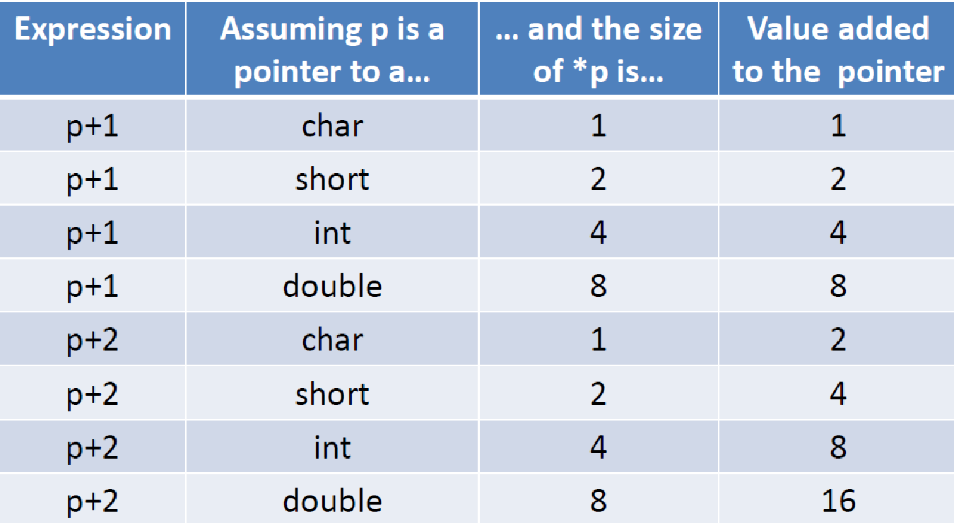
Arrays and Pointers

Slide 29
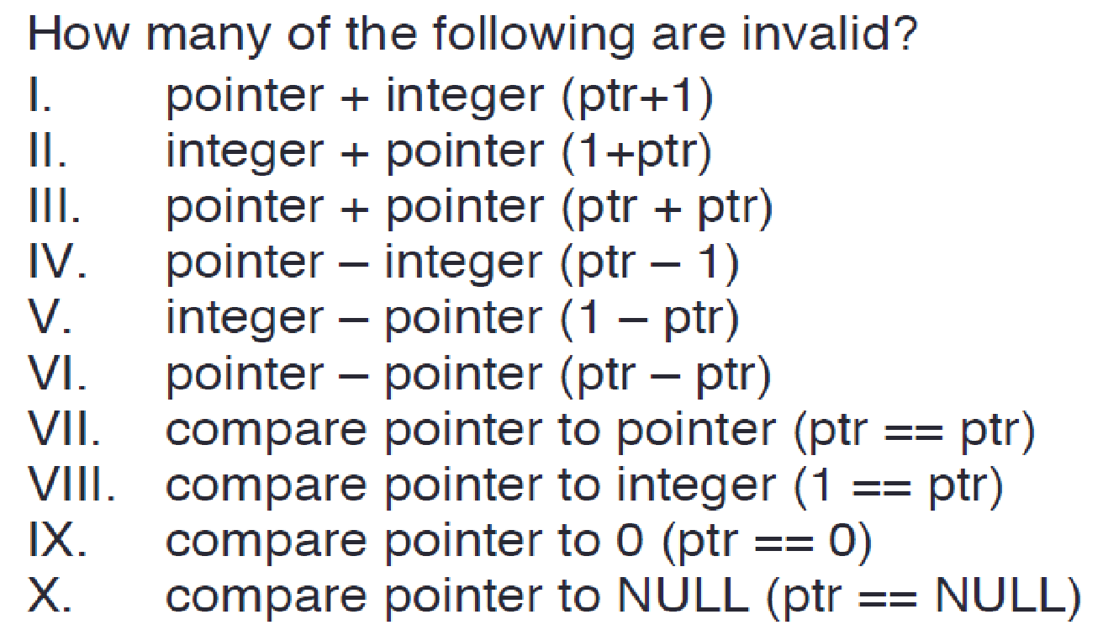
Pointer Arithmetic
Only two types of arithmetic operations allowed:
Addition : only integers can be added
Subtraction: only integers be subtracted
Which of the following are valid/invalid?

Slide 30
Void Pointer
void* is a pointer to no type at all:
Any pointer type may be assigned to void *
int iVar=5;
float fVar=4.3;
char cVar=‘Z’;
int* p1;
void* vp2;
p1 = &iVar; // Allowed
p1 = &fvar; // Not Allowed
P1 = &cVar; // Not Allowed
vp2 = &fvar; // Allowed
vp2 = &cVar; // Allowed
vp2 = &iVar; // Allowed
This is a great advantage…
So, What are the limitations/challenges?

Slide 31
Accessing 1-Demensional Array Using Pointers
We know, Array name denotes the memory address of its first slot.
Example:
int List [ 50 ];
int *Pointer;
Pointer = List;
Other slots of the Array (List [50]) can be accessed using by performing Arithmetic operations on Pointer.
For example the address of (element 4th) can be accessed using:-
int *Value = Pointer + 3;
The value of (element 4th) can be accessed using:-
int Value = *(Pointer + 3);
Address
Data
980
Element 0
982
Element 1
984
Element 2
986
Element 3
988
Element 4
990
Element 5
992
Element 6
994
Element 7
996
Element 8
…
…
998
Element 49

Slide 32
Accessing 1-Demensional Array
Address
Data
….
….
int List [ 50 ];
int *Pointer;
Pointer = List; // Address of first Element
int *ptr;
ptr = Pointer + 3; // Address of 4th Element
*ptr = 293; // 293 value store at 4th element address
}
980
Element 0
982
Element 1
984
Element 2
Element 3
986
293
986
988
Element 4
990
Element 5
992
Element 6
994
Element 7
996
Element 8
…
…
998
Element 49

Slide 33
Accessing 1-Demensional Array
We can access all element of List [50] using Pointers and for loop combinations.
Address
Data
…
…
int List [ 50 ];
int *Pointer;
Pointer = List;
for ( int i = 0; i < 50; i++ )
{
cout << *Pointer;
Pointer++; // Address of next element
}
980
Element 0
982
Element 1
984
Element 2
986
Element 3
988
Element 4
990
Element 5
992
Element 6
994
Element 7
996
Element 8
…
…
998
Element 49
This is Equivalent to
for ( int loop = 0; loop < 50; loop++ )
cout << Array [ loop ] ;

Slide 34
Accessing 2-Demensional Array
Note that the statements
int *Pointer;
Pointer = &List [3];
represents that we are accessing the address of 4th slot.
In 2-Demensional array the statements
int List[ 5 ][ 6 ];
int *Pointer;
Pointer = &List [3];
Represents that we are accessing the address of 4th row
or the address the 4th row and 1st column.
Address
Data
980
Element 0
982
Element 1
984
Element 2
986
Element 3
988
Element 4
990
Element 5
992
Element 6
994
Element 7
996
Element 8
…
…
998
Element 50

Slide 35
Accessing 2-Demensional Array
int List [ 9 ] [ 6 ];
int *ptr;
ptr = &List [3];
To access the address of 4th row 2nd column:
ptr++; // address of 4th row 2nd column
(faster than normal array accessing Why?)
Equivalent to List [3][1] ;
Column
0
1
2
3
4
5
0
300
302
304
306
308
310
1
312
314
316
318
320
322
2
324
326
328
330
332
334
3
336
338
340
342
344
346
Row
4
348
350
352
354
356
358
5
360
362
364
366
368
370
6
372
374
376
378
380
382
7
384
386
388
390
392
394
8
396
398
400
402
404
406
Memory address

Slide 36
Accessing 2-Demensional Array
We know computer can perform only one operation at any time (remember fetch-decode-execute cycle).
Thus to access List [3][1] element (without pointer) two operations are involved:-
First to determine row List [3]
Second to determine column List[3][1]
But using pointer we can reach the element of 4th row 2nd column (directly) by increment our pointer value (which is a single operation).
ptr+1; // 4th row 2nd column
ptr+2; // 4th row 3rd column
ptr+3; // 4th row 4th column
Column
0
1
2
3
4
5
0
300
302
304
306
308
310
1
312
314
316
318
320
322
2
324
326
328
330
332
334
3
336
338
340
342
344
346
Row
4
348
350
352
354
356
358
5
360
362
364
366
368
370
6
372
374
376
378
380
382
7
384
386
388
390
392
394
8
396
398
400
402
404
406
Memory address

Slide 37
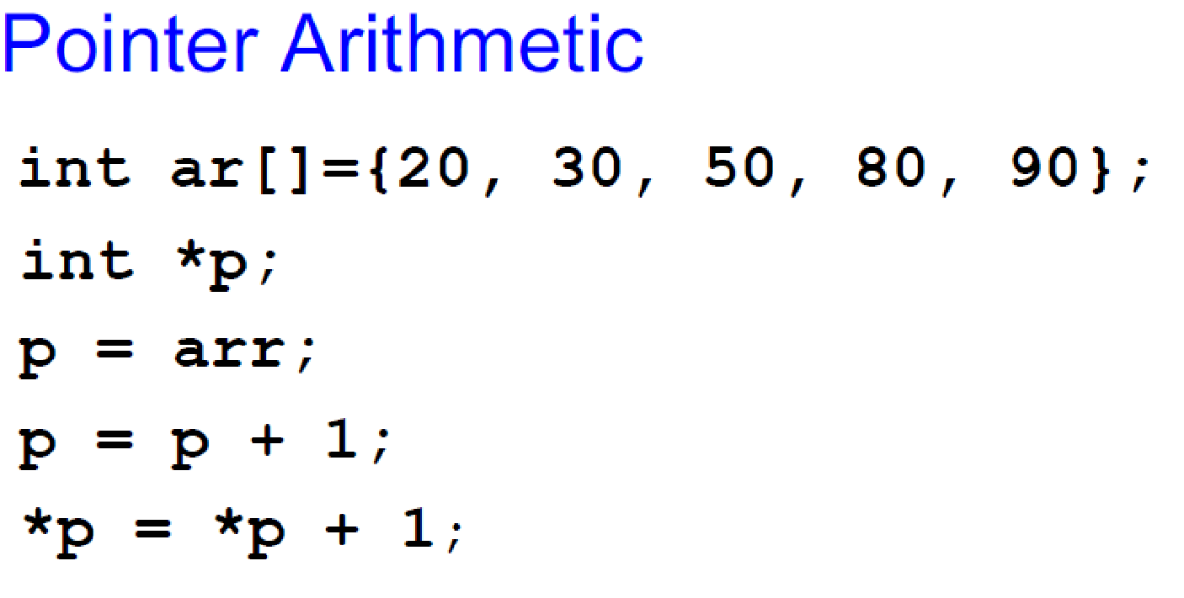
Swapping variables using Pointers
void main() {
char a = ‘A';
char b = ‘Z';
char *Ptr1= &a;
char *Ptr2= &b;
char temp = *Ptr1;
*Ptr1 = *Ptr2;
*Ptr2 = c;
cout << a << b << endl;
}
;

Slide 38
Creating Dynamic 2D Arrays
Two basic methods:
Using a single Pointer
Using a Array of Pointers

Slide 39
Dynamic two dimensional arrays
Using a single Pointer
Total elements in a 2D Array:
m * n (i.e., rows * cols)
5 rows * 4 columns = 20 elements
Target Approach=
allocate 20 elements using dynamic allocation
Use a single pointer to point and access those items.

Slide 40
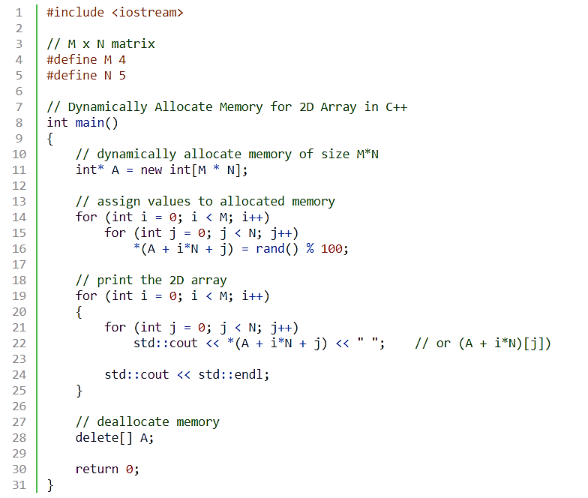
Dynamic 2D Arrays
Notes:
int main(){
int *p= new int[5];
for(int i =0; i<5;i++)
cin>>*(p+i);
for(int i =0; i<5;i++)
cout<<" "<<p[i];
return 0;}

Slide 41
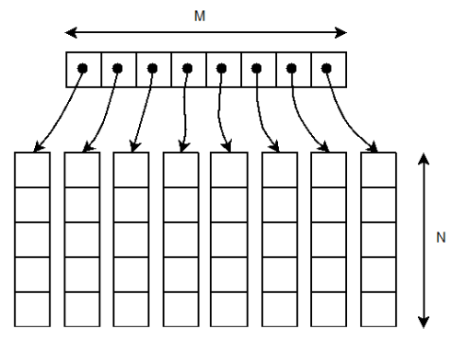
Dynamic 2D Array – Double Pointer
Using a Pointer that points to Array of Pointer
Total elements in a 2D Array: M_rows * N_coulmns
Ptr2D
(Pointer to a Pointer)

Slide 42
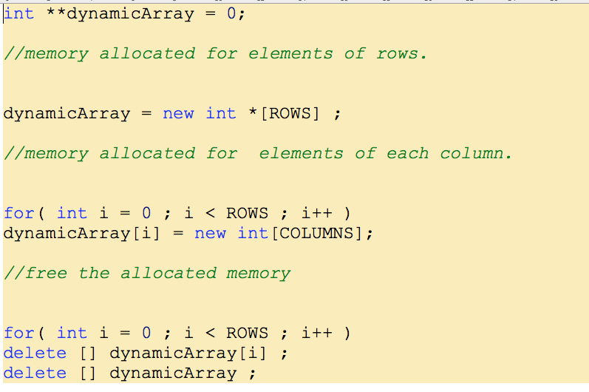
Dynamic 2D Array – Double Pointer
Notes:
The bracket operator is implemented by computing the address of the ith object
base = A = address of A[0] address of element i = base + offset = base + i * sizeof(T) A[i] = reference to element at this address Pointer must know its type to compute addresses using sizeof(T)
Note carefully the distinction between A and A[0]

Slide 43
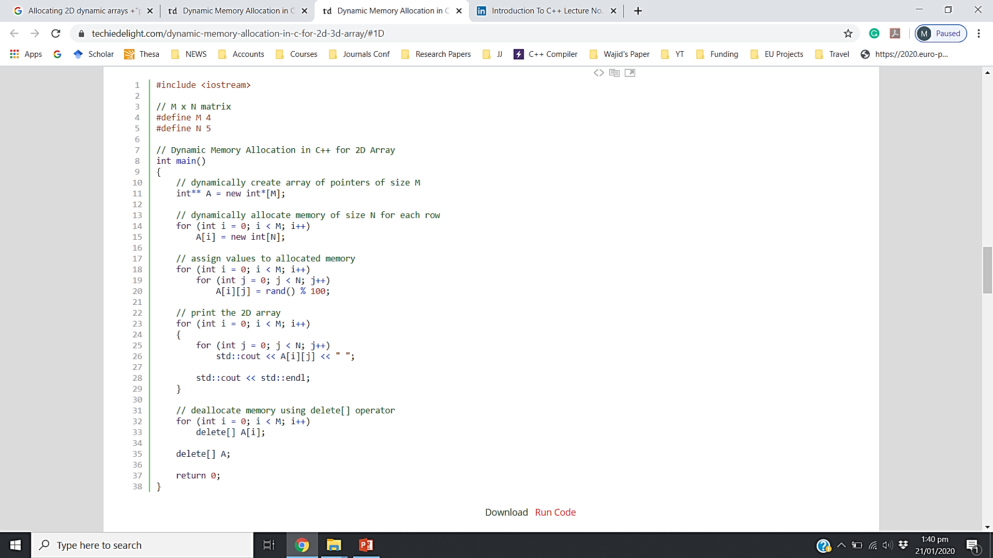
Dynamic two dimensional arrays
Can we vary size of each column in Dynamic 2D Array (using double pointer)
PP 🡪 start of array of pointers
*PP 🡪 First Address pointed by first row (sub array)
*(*PP) 🡪 First value of first array
(*PP)++ 🡪 Move to next address in the first array
PP++ 🡪 Move to Next row (second array address
Notes:
Access using a single pointer:
*pp 🡪 start of array of pointers

Slide 44
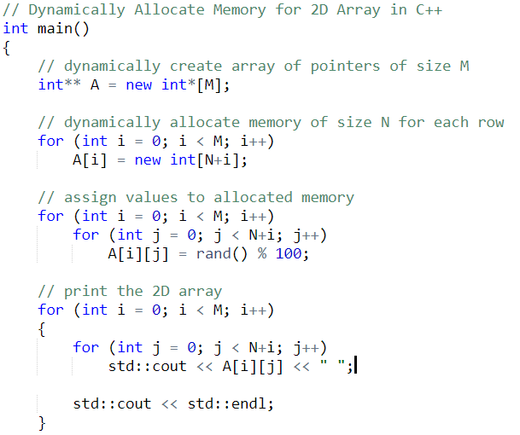
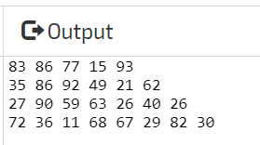
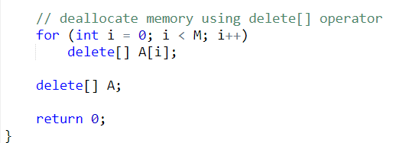
Dynamic 2D Array (Varying Row Size)

Slide 45
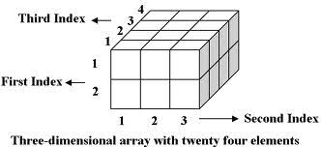
Home Work
- Manipulating a 3D Array
Using a single pointer
Using a triple pointer

Slide 46
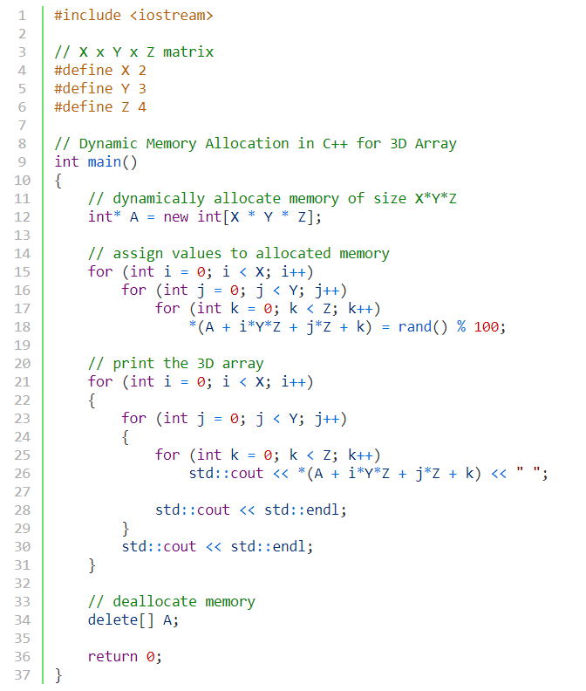
3D Array Using a single pointer

Slide 47
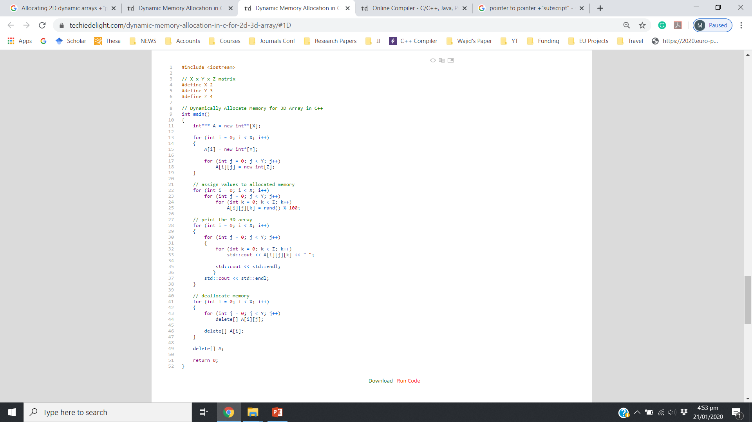
3D Array Using a triple pointer

